Slide 1


Brigham and Women’s Hospital
Founding Member, Mass General Brigham
Harvard Medical School
Yoga and the Science of Sleep
The Janki Foundation for Spirituality in Healthcare
Brahma Kumaris World Spiritual University
Global Co-operation House, London
July 27, 2026
Sat Bir S. Khalsa, Ph.D.
Corresponding Member of the Faculty of Medicine, Harvard Medical School
Director of Research, Kundalini Research Institute
Editor in Chief, International Journal of Yoga Therapy
Research Associate, Benson Henry Institute for Mind Body Medicine
Research Affiliate, Osher Center for Integrative Medicine

Slide 2
Sleep

Slide 3
Sleep
A biological need
Sleep : Wakefulness
An active process
A complex process

Slide 4
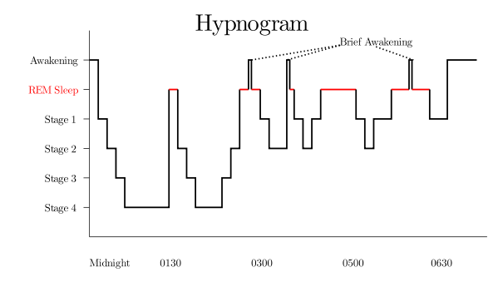

Slide 5
Physiologic Determinants
Sleep and Wakefulness
Biological Time of Day (circadian phase)
Number of Hours Awake
Nightly Sleep Duration
Sleep Inertia

Slide 6
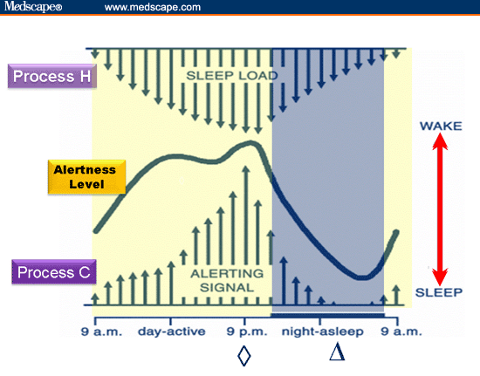

Slide 7
Self-Restricted Sleep

Slide 8
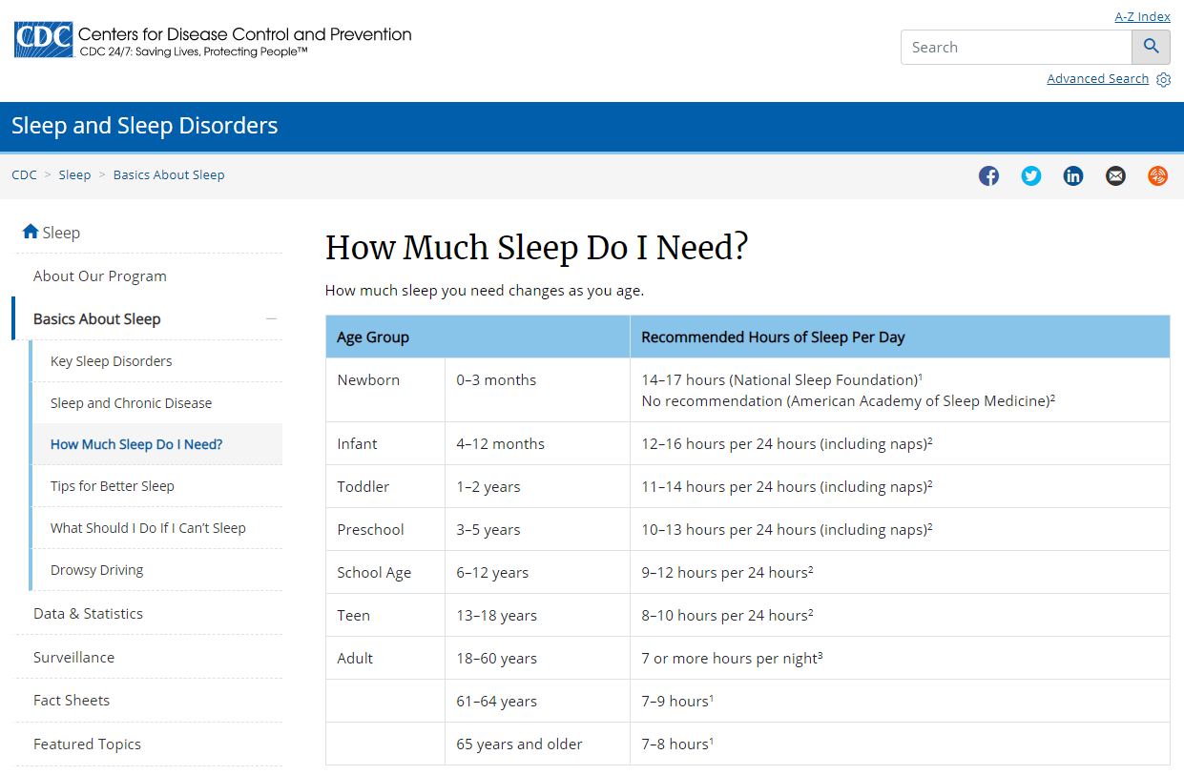

Slide 9
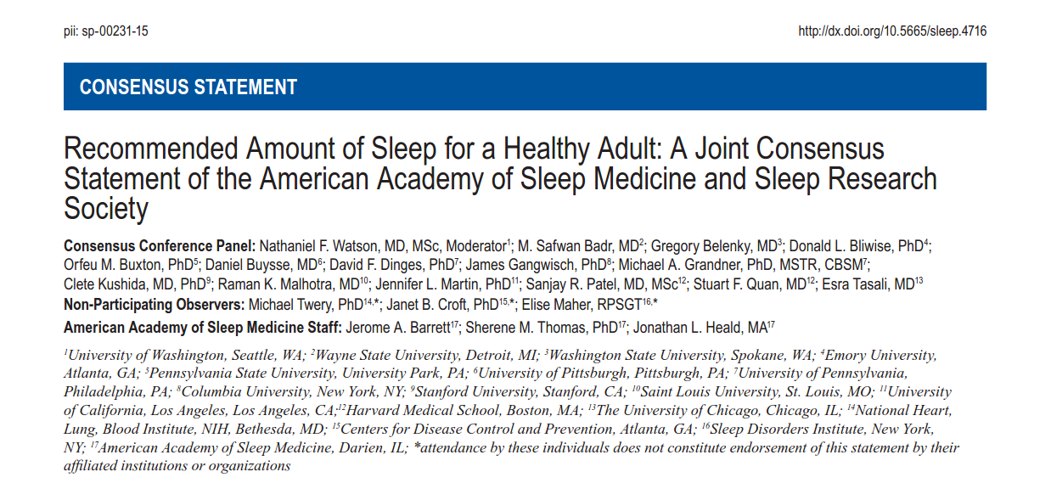
• Adults should sleep 7 or more hours per night on a regular basis to promote optimal health.
• Sleeping less than 7 hours per night on a regular basis is associated with adverse health outcomes, including weight gain and obesity, diabetes, hypertension, heart disease and stroke, depression, and increased risk of death. …also associated with impaired immune function, increased pain, impaired performance, increased errors, and greater risk of accidents.

Slide 10
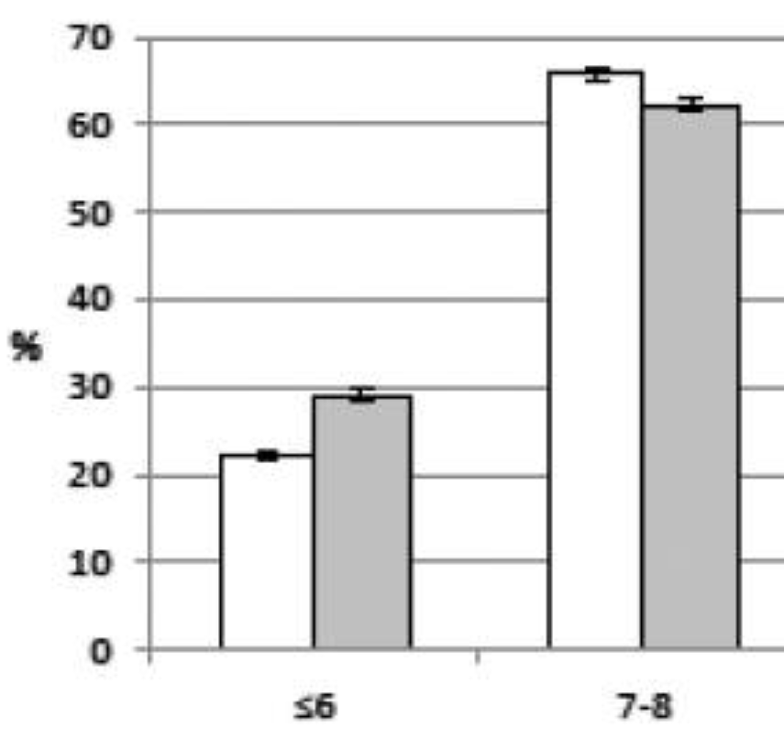
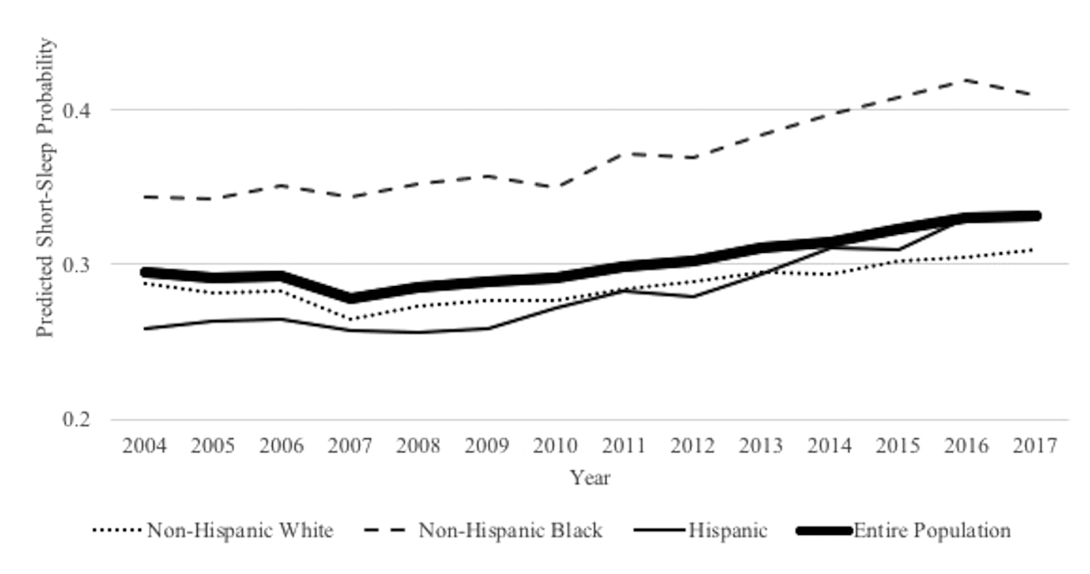

Sleep Deficiency Trend
From: Trends in Self-Reported Sleep Duration among US Adults from 1985 to 2012, Ford ES, Cunningham TJ, Croft JB, Sleep 38:829-32, 2015.
Are U.S. adults reporting less sleep?: Findings from sleep duration trends in the National Health Interview Survey, 2004-2017. Sheehan CM, Frochen SE, Walsemann KM, Ailshire JA. Sleep. 42(2):zsy221, 2019.

Slide 11
Consequences of Sleep Deficiency
Behavioral Impairment Risk for Disorders
Alertness
Reaction Time
Mood
Accidents
Executive Cognition
Learning
Memory
Immune Function
Alcohol Use
Appetite
Obesity
Diabetes
Heart Disease
Stroke
Hypertension
Depression
Anxiety
Stress
Cancer
Mortality

Slide 12
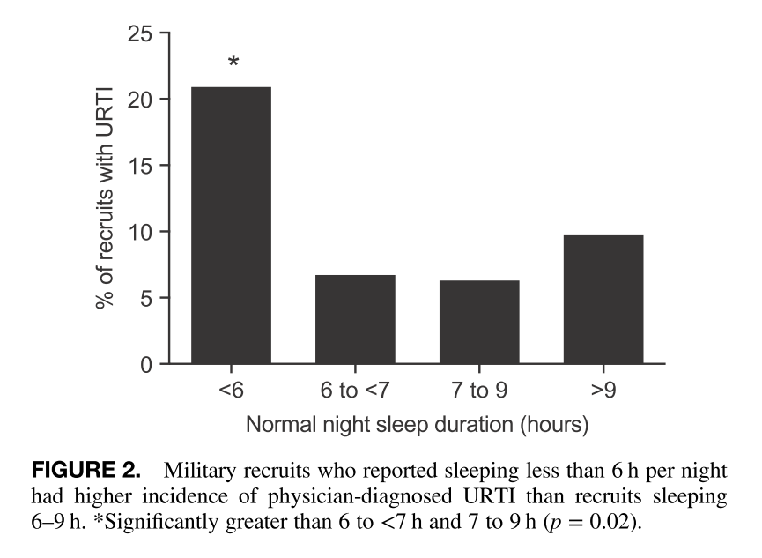
Sleep Deprivation and
Immune Function
From: Increased Risk of Upper Respiratory Infection in Military Recruits Who Report Sleeping Less Than 6 h per night. Wentz LM, Ward MD, Potter C, Oliver SJ, Jackson S, Izard RM, Greeves JP, Walsh NP. Military Medicine, 183:e699-e704, 2018.
https://academic.oup.com/milmed/article/183/11-12/e699/4994227

Slide 13
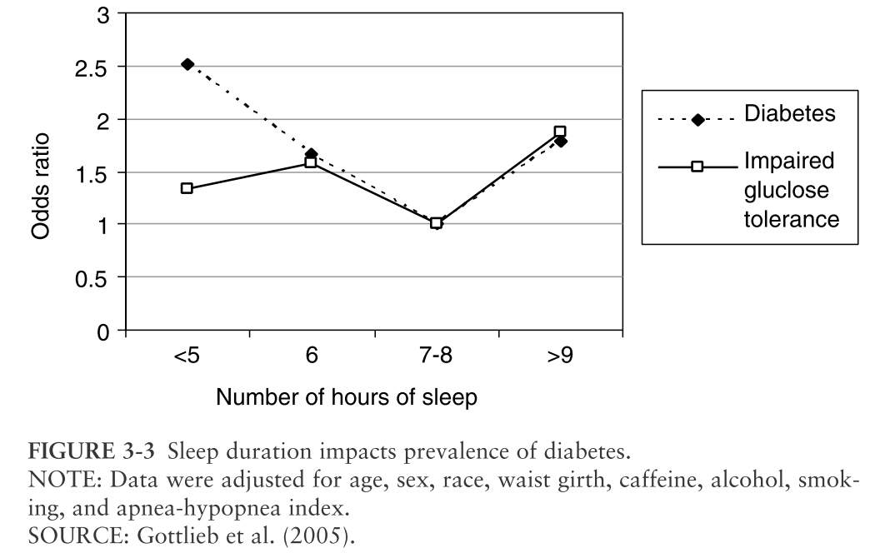
Cumulative Sleep Deprivation
Glucose Regulation
From: Sleep Disorders and Sleep Deprivation: An Unmet Public Health Problem, Institute of Medicine (US) Committee on Sleep Medicine and Research, Colten HR, Altevogt BM, editors. Washington (DC): National Academies Press (US); 2006.
file:///G:/Bookshelf_NBK19960.pdf

Slide 14
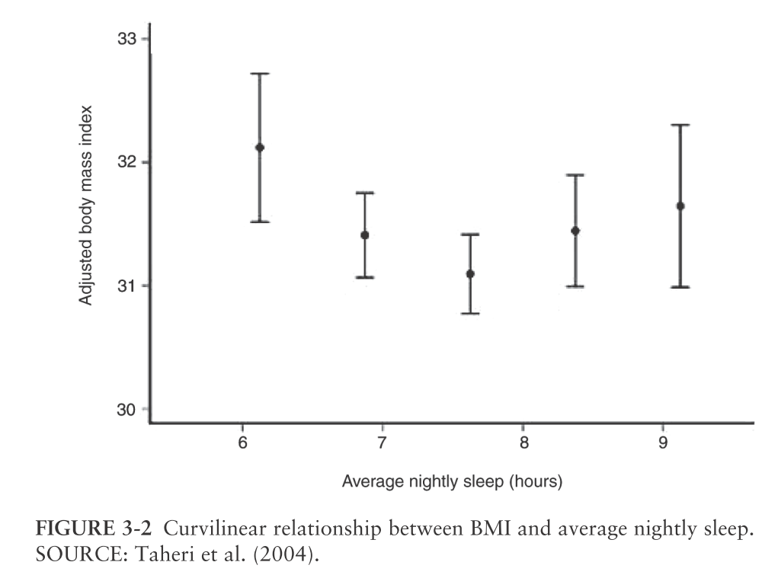
Cumulative Sleep Deprivation
Weight
From: Sleep Disorders and Sleep Deprivation: An Unmet Public Health Problem, Institute of Medicine (US) Committee on Sleep Medicine and Research, Colten HR, Altevogt BM, editors. Washington (DC): National Academies Press (US); 2006.
file:///G:/Bookshelf_NBK19960.pdf

Slide 15
Sleep Disorders

Slide 16
Sleep Disorders
Three major categories:
Parasomnias
Disorders of excessive daytime sleepiness
Insomnia

Slide 17
Disorders of Excessive Daytime Sleepiness
Defining Hypersomnolence
Must be distinguished from fatigue.
Is a tendency to fall asleep unintentionally in passive situations:
  Reading
  Watching television
  Driving
  Lectures

Slide 18
Differential Diagnosis
of Excessive Daytime Sleepiness
Increased Sleep Drive:
Narcolepsy
Primary Central Nervous System Hypersomnolence
Sleep Disruption:
Obstructive Sleep Apnea
Periodic Limb Movement Disorder
Restless Legs Syndrome
Inadequate Sleep:
Self Imposed Sleep Restriction
Shift Work
Other

Slide 19
Sleep Apnea

Slide 20
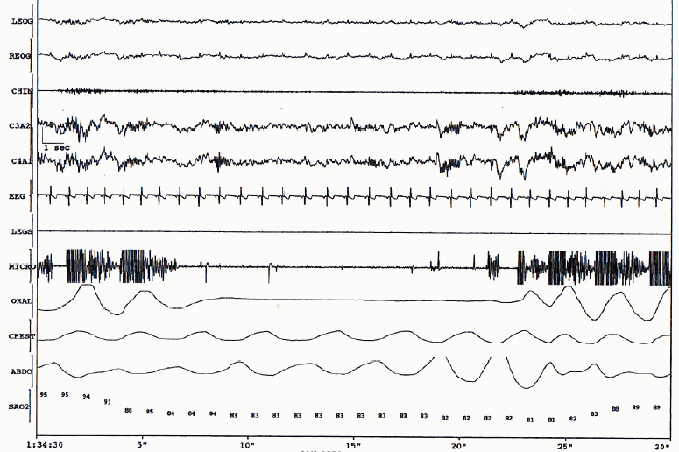
Sleep Apnea Recording

Slide 21
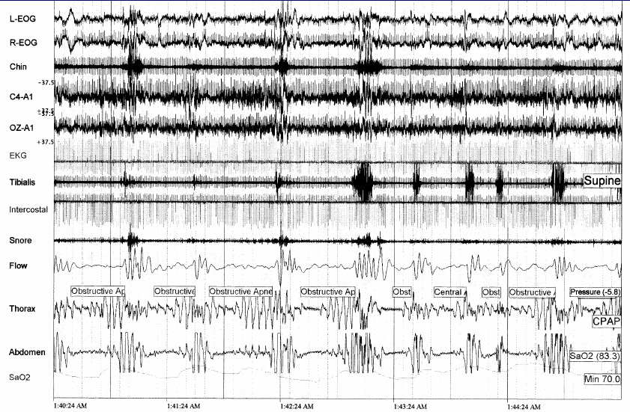
Sleep Apnea Recording

Slide 22
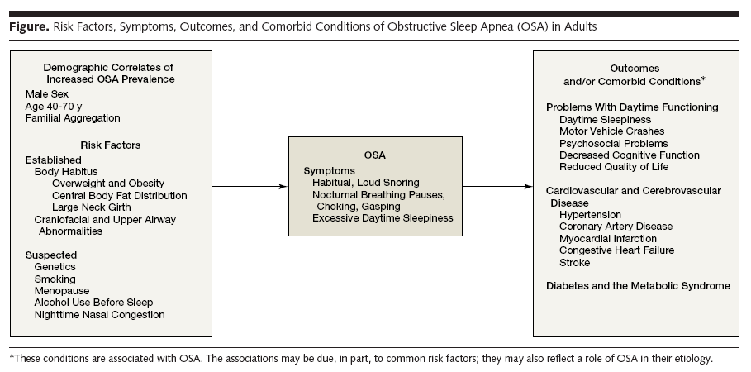
Sleep Apnea
Risk Factors and Consequences
From: Risk factors for obstructive sleep apnea in adults. Young T, Skatrud J, Peppard PE. Journal of the American Medical Association 291:2013-2016, 2004.

Slide 23
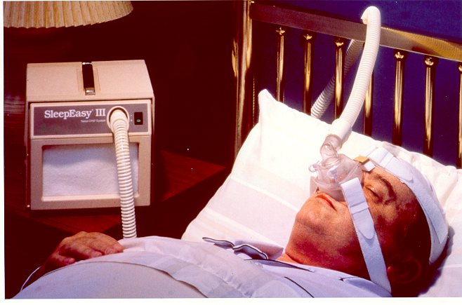
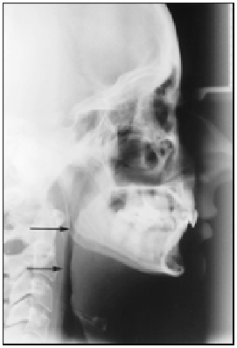
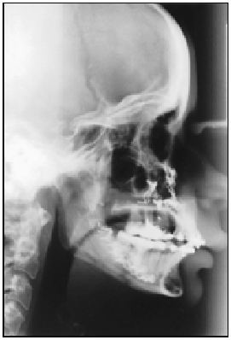
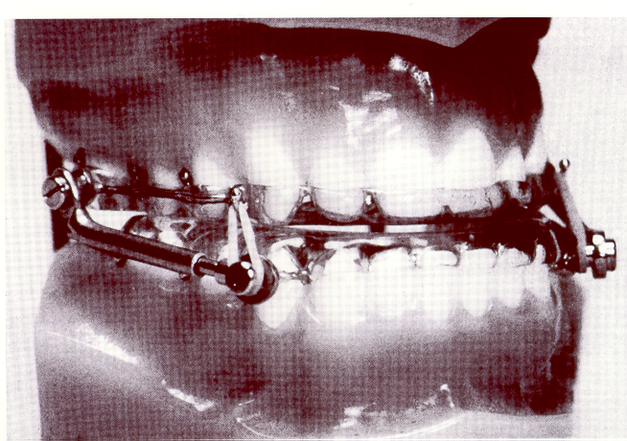
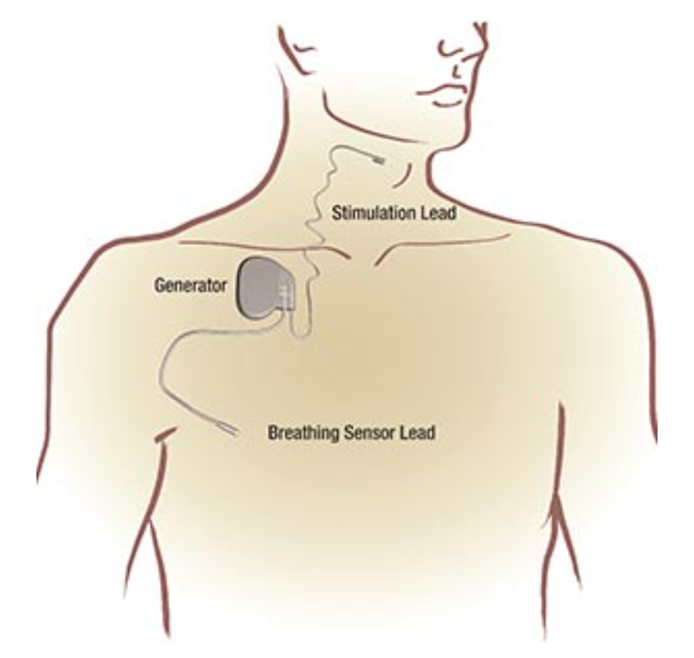
OSA Treatments

Slide 24
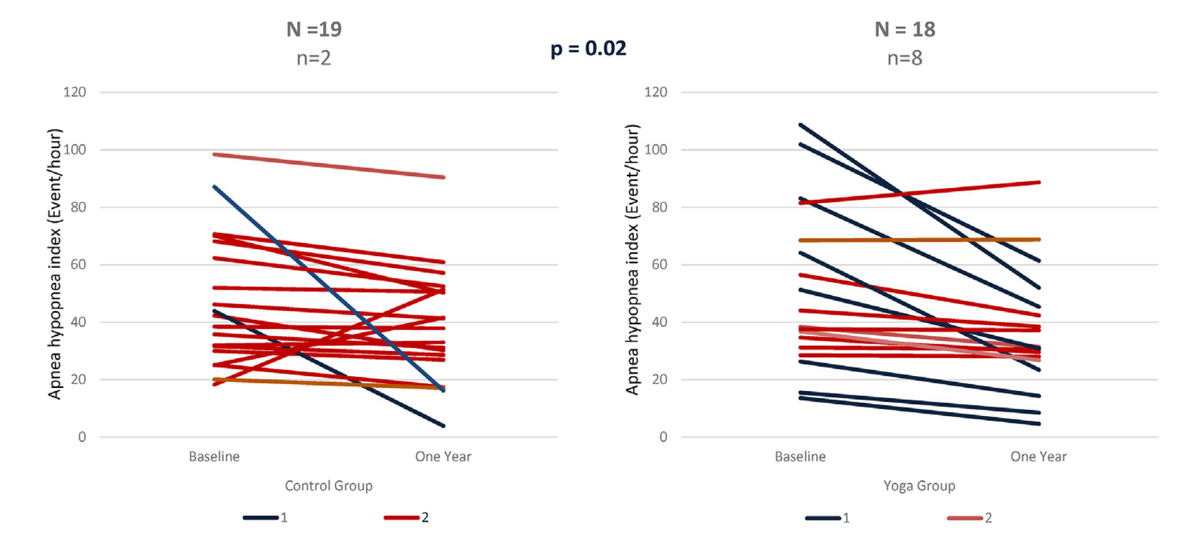
Yoga vs. Exercise/Diet for OSA
“Lifestyle modification through Yoga and a modified Indian diet may be effective in the reduction of OSA severity in obese patients.”
From: Effect of yoga-based lifestyle and dietary modification in overweight individuals with sleep apnea: A randomized controlled trial (ELISA). Gupta A, Kaur J, Shukla G, Bhullar KK, Lamo P, Kc B, Agarwal A, Srivastava AK, Sharma G. Sleep Medicine, 107:149-156, 2023.

Slide 25
Insomnia:
Prevalence, Characteristics,
Etiology,
Treatment

Slide 26
Insomnia Prevalence
“Approximately 10% of the adult population suffers from an insomnia disorder and another 20% experiences occasional insomnia symptoms. Women, older adults, and people with socioeconomic hardship are more vulnerable to insomnia. Insomnia is often a chronic condition, with a 40% persistence rate over a 5-year period.”
From: Epidemiology of Insomnia: Prevalence, Course, Risk Factors, and Public Health Burden. Morin CM, Jarrin DC. Sleep Med Clin. 2022 Jun;17(2):173-191.
“Insomnia is highly prevalent in clinical practice, occurring in up to 50% of primary care patients.”
From: Insomnia. Perlis ML, Posner D, Riemann D, Bastien CH, Teel J, Thase M.
Lancet. 2022 Sep 24;400(10357):1047-1060.

Slide 27
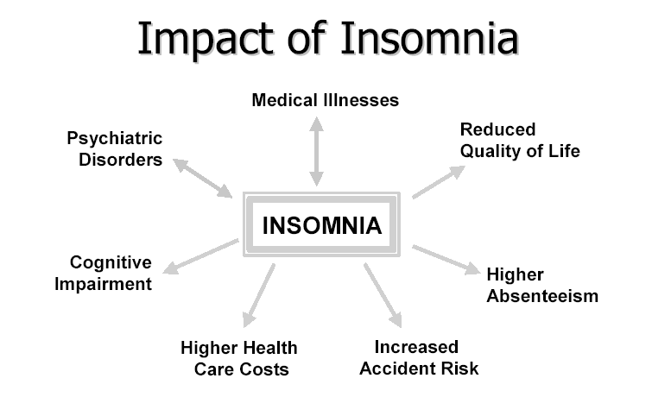
From: Consequences of insomnia and its therapies. Benca RM. J Clin Psychiatry. 2001;62 Suppl 10:33-8.
“Insomnia can present independently or alongside other medical conditions or mental health disorders and is a risk factor for the development and exacerbation of these other disorders if not treated.”
From: Insomnia. Perlis ML, Posner D, Riemann D, Bastien CH, Teel J, Thase M.
Lancet. 2022 Sep 24;400(10357):1047-1060.

Slide 28
Insomnia Presentation
Sleep onset insomnia
Sleep maintenance insomnia
Poor quality/non-restorative sleep

Slide 29
Medications
and substances
• Acute use
• Chronic use
• Withdrawal
Circadian Factors
• Jet lag
• Shift work
• Advanced, delayed
sleep phases
Medical/Neurological
Factors
• Pain, discomfort
• Specific disorders
Environmental
Factors
• Physical discomfort
• Noise
• Light
Psychiatric or
Psychological Factors
• Depression or Anxiety
• Bereavement
• Acute stress
Primary
Sleep Disorders
• Restless Legs Syndrome
• Periodic limb movements
• Respiratory arousals
• Parasomnias
From: The evaluation and treatment of insomnia, Buysse DJ, Perlis ML, Journal of Practical Psychiatry and Behavioral Health. 10:541-553, 1987.
INSOMNIA

Slide 30
Medications
and substances
• Acute use
• Chronic use
• Withdrawal
Circadian Factors
• Jet lag
• Shift work
• Advanced, delayed
sleep phases
Medical/Neurological
Factors
• Pain, discomfort
• Specific disorders
Environmental
Factors
• Physical discomfort
• Noise
• Light
Psychiatric or
Psychological Factors
• Depression or Anxiety
• Bereavement
• Acute stress
Primary
Sleep Disorders
• Restless Legs Syndrome
• Periodic limb movements
• Respiratory arousals
• Parasomnias
Behavioral,
Psychophysiological,
and Conditioning Factors
• Fear, frustration with insomnia
• Sleep-incompatible behaviors
• Increased arousal
INSOMNIA

Slide 31
Medications
and substances
• Acute use
• Chronic use
• Withdrawal
Circadian Factors
• Jet lag
• Shift work
• Advanced, delayed
sleep phases
Medical/Neurological
Factors
• Pain, discomfort
• Specific disorders
Environmental
Factors
• Physical discomfort
• Noise
• Light
Psychiatric or
Psychological Factors
• Depression or Anxiety
• Bereavement
• Acute stress
Primary
Sleep Disorders
• Restless Legs Syndrome
• Periodic limb movements
• Respiratory arousals
• Parasomnias
Behavioral,
Psychophysiological,
and Conditioning Factors
• Fear, frustration with insomnia
• Sleep-incompatible behaviors
• Increased arousal
INSOMNIA

Slide 32
Behavioral,
Psychophysiological,
and Conditioning Factors
• Fear, frustration with insomnia
• Sleep-incompatible behaviors
• Increased arousal
INSOMNIA

Slide 33
Insomnia Treatment
  Treat underlying cause (secondary insomnia)
    Pain, depression, anxiety, sleep disordered breathing, restless legs syndrome
  Pharmacological Treatments
  Behavioral Treatments

Slide 34
Behavioral Treatments for Insomnia
Sleep Hygiene General sleep-specific recommendations for facilitating sleep
Stimulus control Association/Reassociation of the bed/bedroom solely for sleep or sex
Cognitive therapy Challenge dysfunctional beliefs and misperceptions about sleep and insomnia
Sleep restriction Improve sleep continuity by limiting
time spent in bed
Relaxation training Relaxation treatments employing cognitive and/or somative techniques to reduce tension and arousal

Slide 35
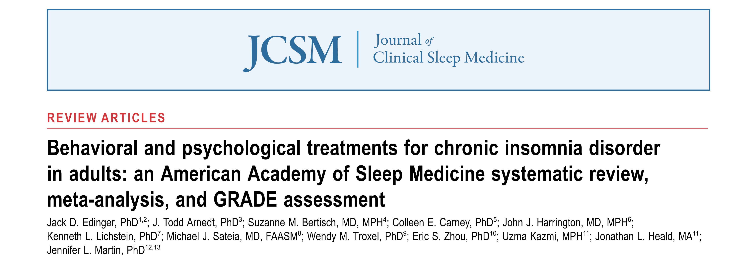
“There have been decades of research studying behavioral and psychological treatments for insomnia disorder in adults, and several recent international guidelines have recommended CBT-I as ﬁrst-line therapy for patients with insomnia.”

Slide 36
Yoga for Sleep

Slide 37


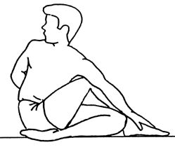
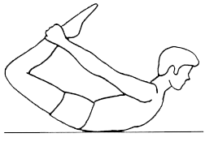
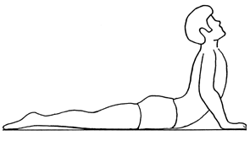
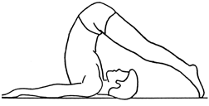
Basic Elements of Yoga Practice
Physical postures/exercises
Breathing exercises
Deep Relaxation
Meditation

Slide 38
Yoga Practices
Postures, Breathing, Relaxation, Meditation
Fitness
↑Flexibility
↑Strength
↑Coordination/Balance
↑Respiratory Function
↑Self-Efficacy
Self-Regulation
↑Stress Regulation
↑Emotion Regulation
↑Resilience
↑Equanimity
↑Self-Efficacy
Awareness
↑Attention
↑Mindfulness
↑Concentration
↑Cognition
↑Meta-cognition

Slide 39
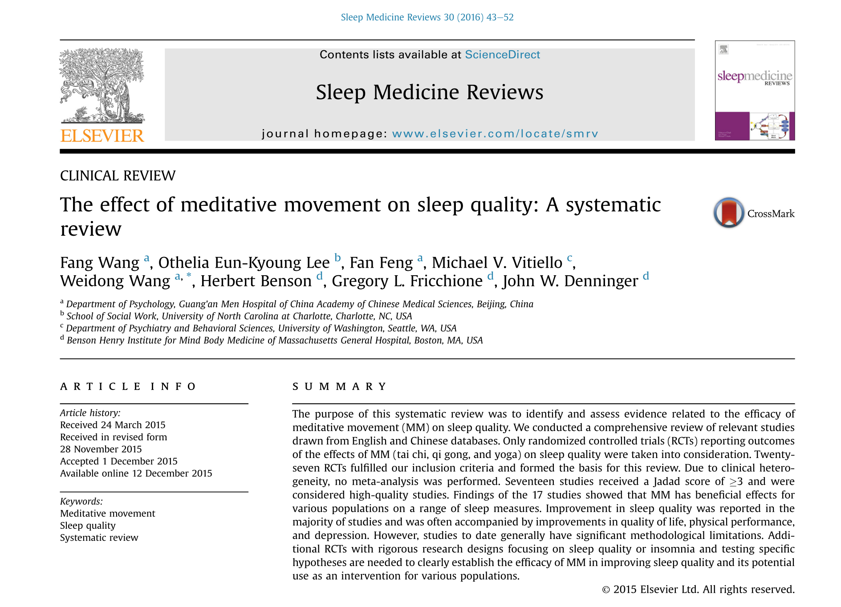

Slide 40
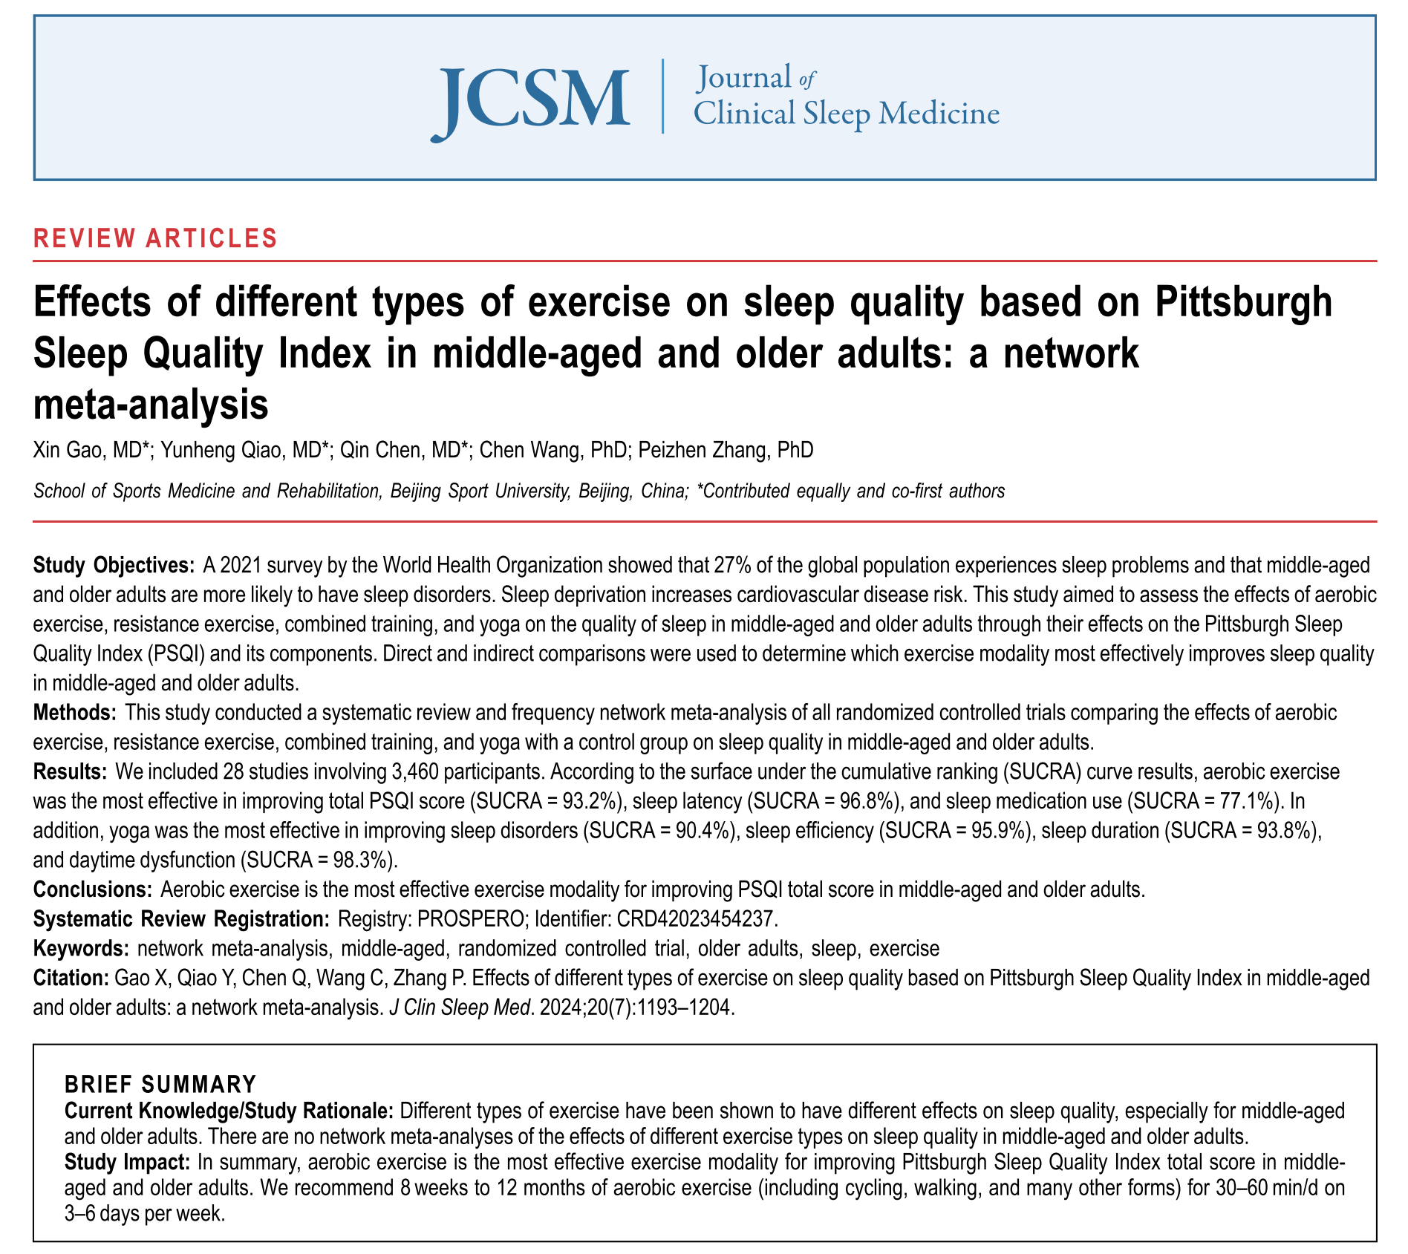

Slide 41
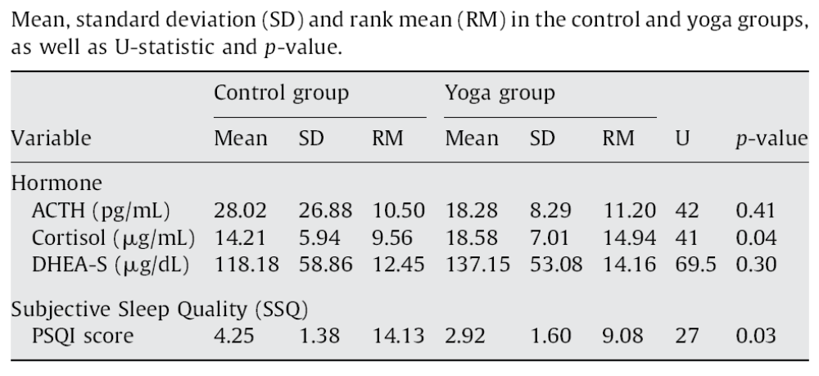
Sleep in Yoga Practitioners
From: Subjective sleep quality and hormonal modulation in long-term yoga practitioners,
Vera FM, Manzaneque JM, Maldonado EF, Carranque GA, Rodriguez FM, Blanca MJ, Morell M, Biological Psychology 81:164-8, 2009.

Slide 42
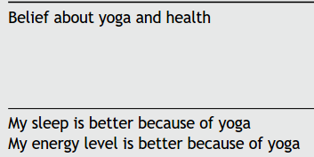
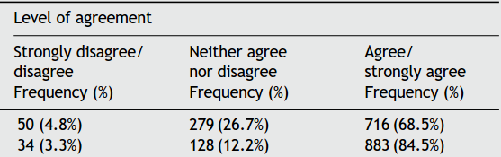
Perceptions of Yoga on Sleep
From: National survey of yoga practitioners: mental and physical health benefits, Ross A, Friedmann E, Bevans M, Thomas S, Complementary Therapies Medicine, 21:313-23, 2013.

Slide 43
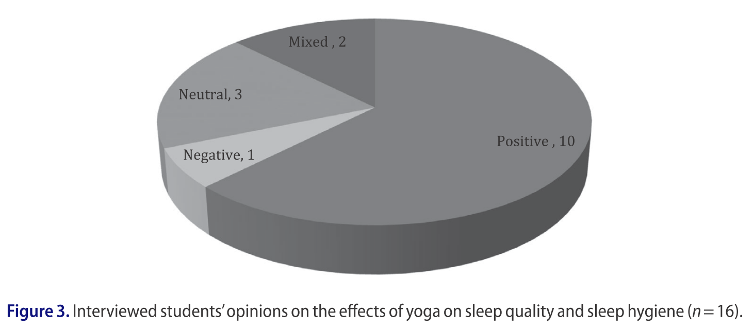
Yoga on Sleep in Students
“Yoga deﬁnitely helped with sleeping ... it would take me a long time to get to sleep. When I was doing yoga it was much easier to fall asleep and stay asleep.”
“I think I’ve been [sleeping] deeper and more comfortably because also, along with the foot on the wall, I also do the three part breathing so that I can relax myself before I try and fall asleep.”
“Yea, I can sleep a lot better, fall asleep faster.”
From: Qualitative evaluation of a high school yoga program: Feasibility and perceived benefits, Conboy LA, Noggle JJ, Frey JL, Kudesia RS, Khalsa SBS, Explore: The Journal of Science & Healing, 9:171-180, 2013.
A Qualitative Examination of Yoga for Middle School Adolescents, Butzer B, LoRusso AM, Windsor R, Riley F, Frame K, Khalsa SBS, Conboy L., Advances in School Mental Health Promotion, 10(3):195-219, 2017.

Slide 44
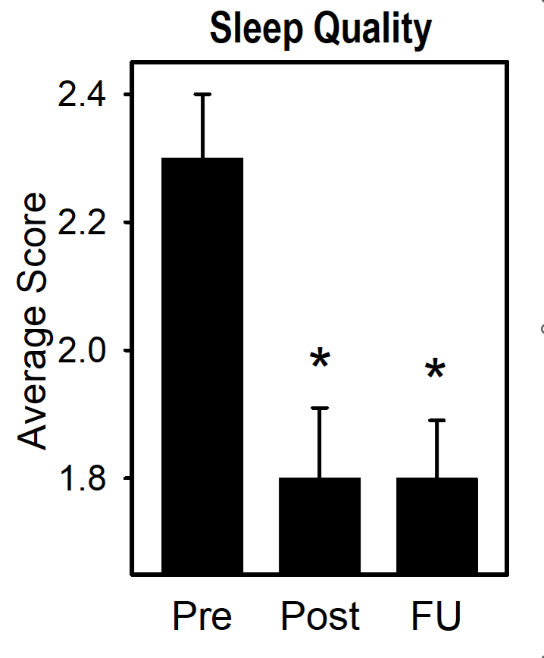
Yoga for Mental Health in Educators
From: Improvements in Psychological and Occupational Well-being Following a Brief Yoga-Based Program for Education Professionals. Trent NL, Borden S, Miraglia M, Pasalis E, Dusek JA, Khalsa SBS.
Global Advances in Health and Medicine Jun 11;8:2164956119856856, 2019.

Slide 45
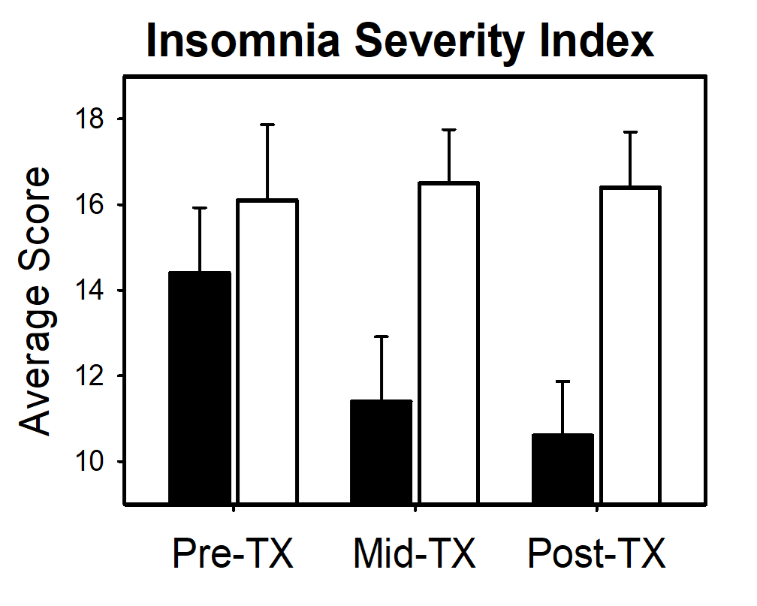
Yoga for PTSD
From: A Yoga Intervention for Posttraumatic Stress: A Preliminary Randomized Control Trial, Evidence-Based Complementary and Alternative Medicine, Jindani F, Turner N, Khalsa SBS, 351746, 2015.

Slide 46
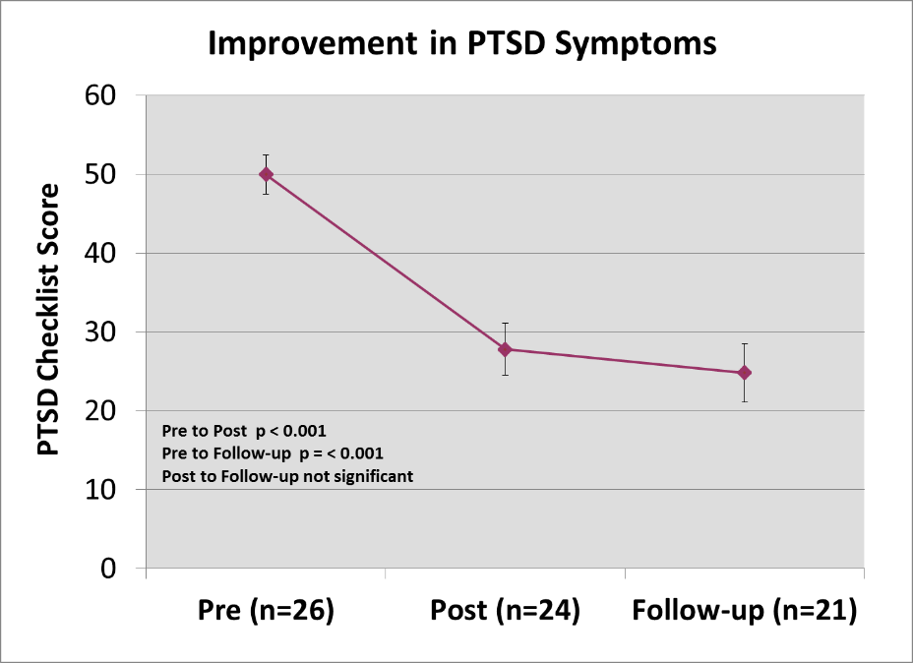
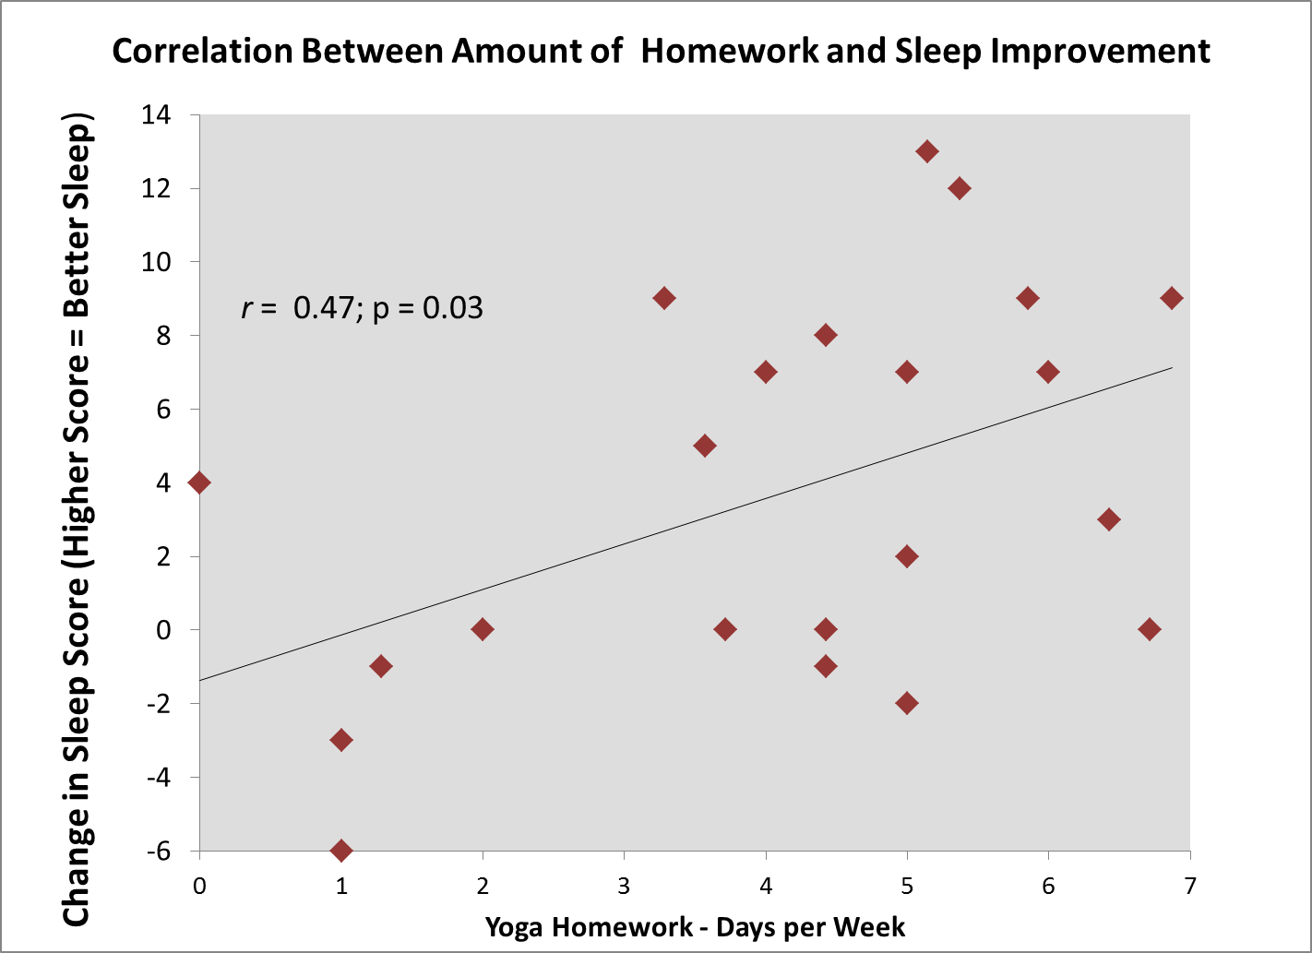
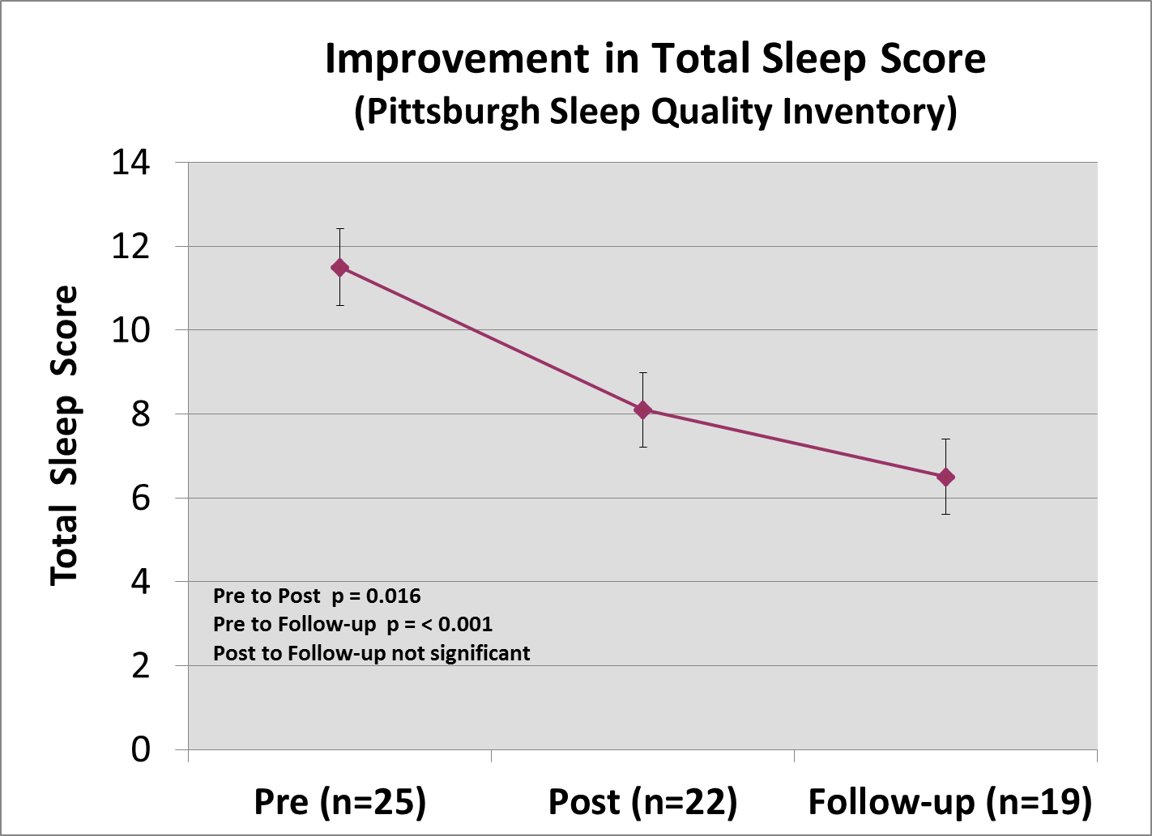
Yoga and CBT for PTSD
From: Evaluation of a Combined Yoga and Cognitive Behavioral Therapy Program for Posttraumatic Stress Disorder, Staples JK, Mintie D, Khalsa SBS, Journal of Alternative and Complementary Medicine 22, No. 6, Abstracts 2016.
Pittsburgh Sleep Quality Index
PSQI Score

Slide 47
Insomnia and Hyperarousal

Slide 48
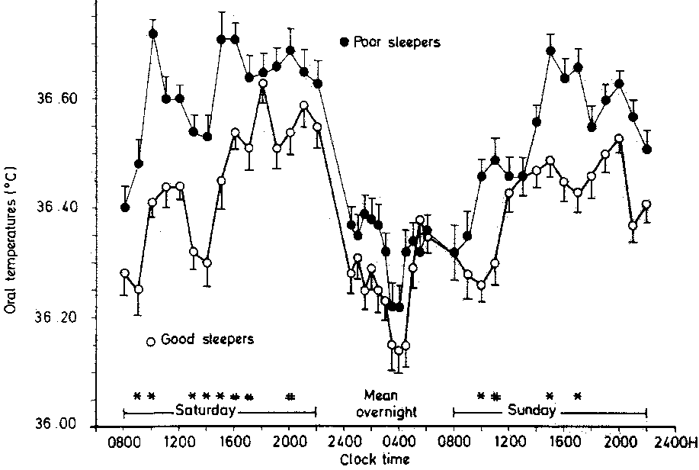
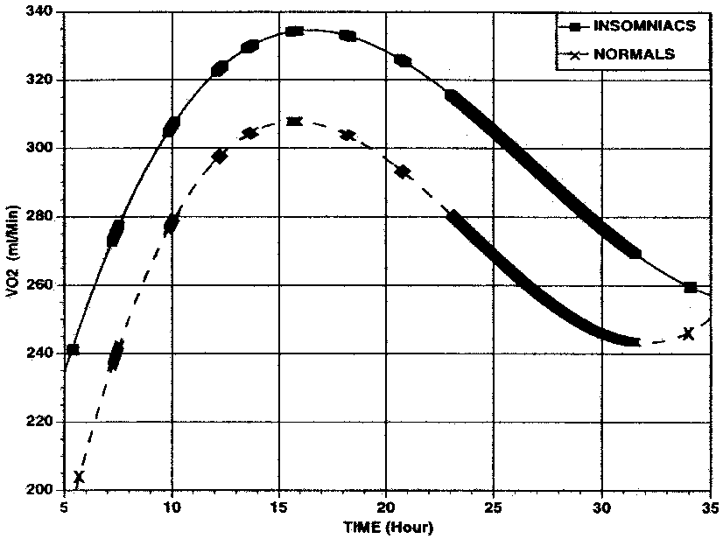
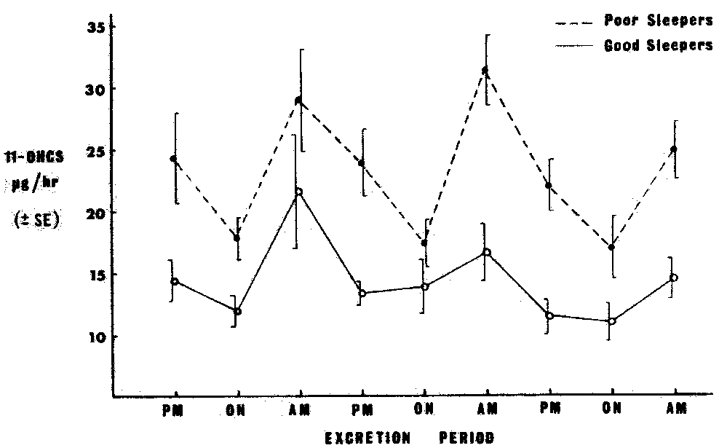
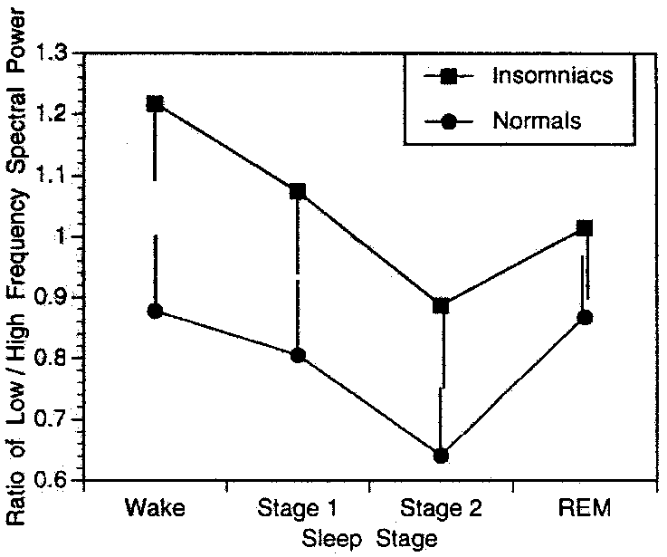
Physiological Arousal in Insomnia
Adam K et al, J Psychiatr Res, 1986
Bonnet MH & Arand DL, Sleep, 1995
Johns MW et al., Psychosom Med, 1971
Bonnet MH & Arand DL, Psychosom Med, 1998

Slide 49
Insomnia as Disorder of Hyperarousal
“Taken together, evidence … supports the contention that primary insomniacs suffer from a disorder of hyperarousal and that the elevated arousal produces the poor sleep and other symptoms reported by patients. It is therefore suggested that new treatment strategies directed at reduction of arousal level be considered in these patients.”
From: Hyperarousal and insomnia, Bonnet MH & Arand DL, Sleep Medicine Reviews 1:97-108, 1997.

Slide 50
Relaxation-Related
Treatments for Insomnia
Physical exercise
Progressive muscle relaxation
Breath regulation
Meditation
Meditative movement: yoga, tai chi

Slide 51

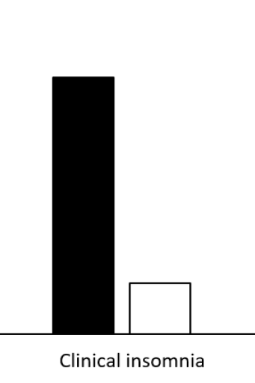
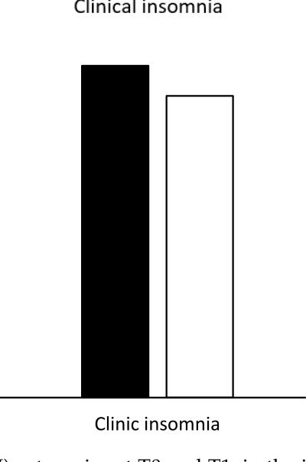


Exercise for Insomnia
Control
Exercise
From: Effect of Aerobic Exercise Training on Sleep and Core Temperature in Middle-Aged Women with Chronic Insomnia: A Randomized Controlled Trial. Baron P, Hermand É, Bourlois V, Pezé T, Aron C, Lombard R, Hurdiel R. Int J Environ Res Public Health. 20(8):5452, 2023.

Slide 52
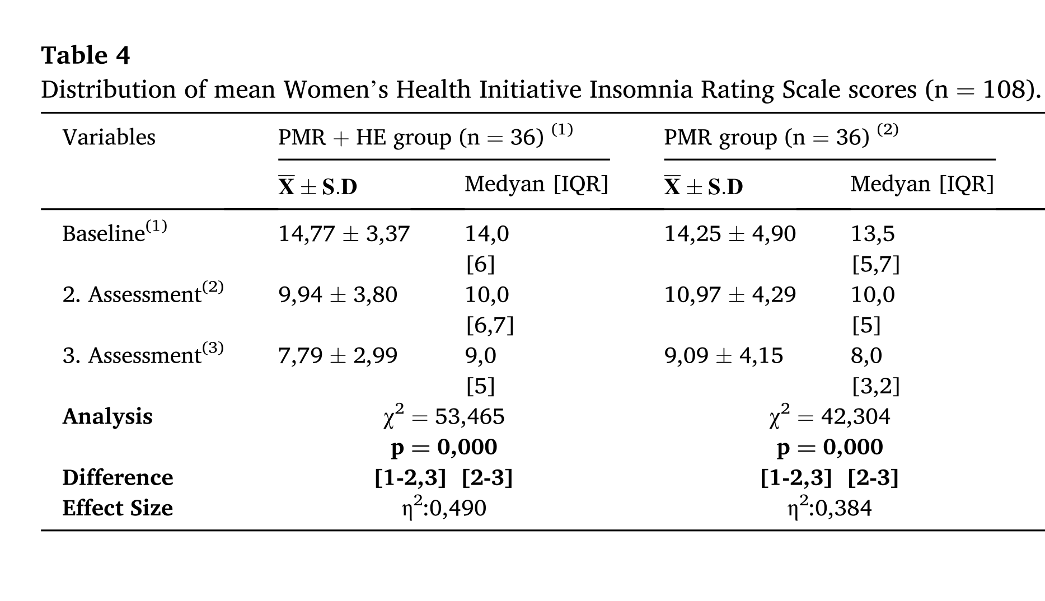
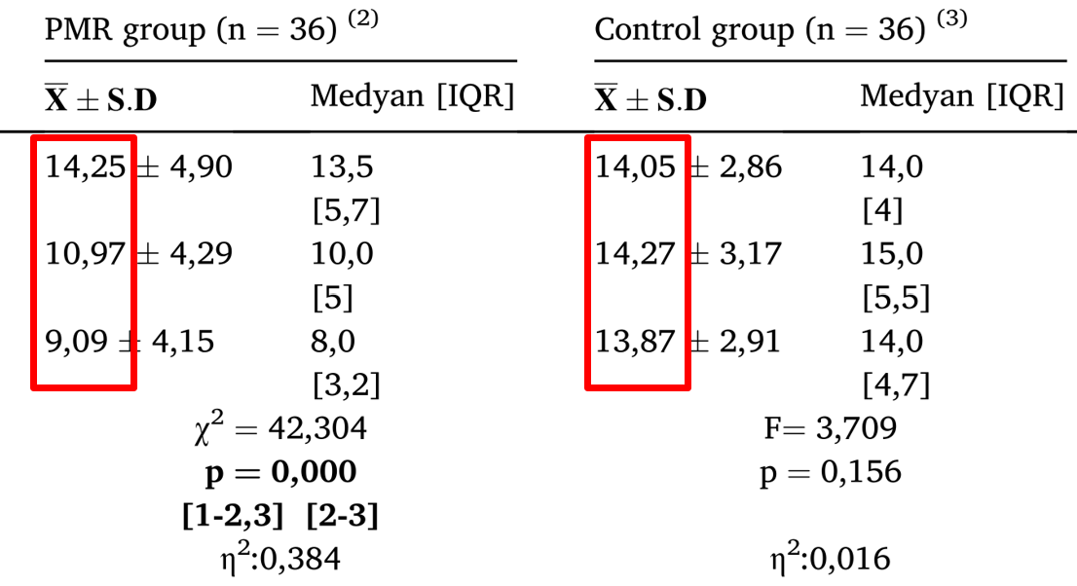
Progressive Relaxation for Insomnia
From: Effects of health education and progressive muscle relaxation on vasomotor symptoms and insomnia in perimenopausal women: A randomized controlled trial.
Pelit Aksu S, Şentürk Erenel A. Patient Educ Couns. 105(11):3279-3286, 2022.

Slide 53
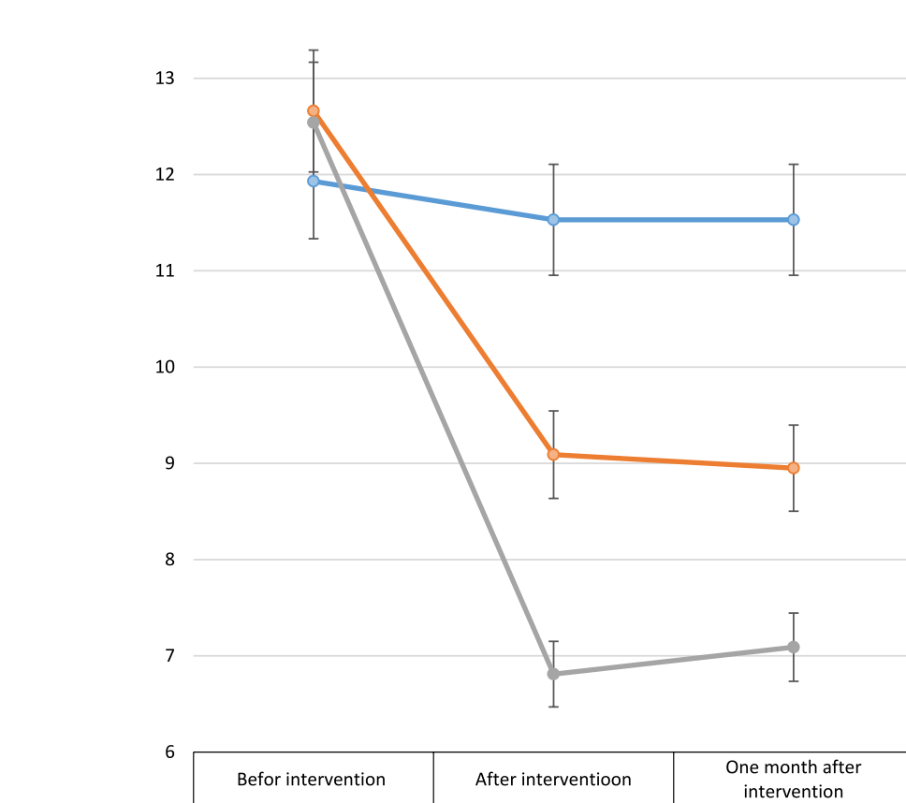
Breath Regulation for Insomnia
Control
Sleep Quality
CBT
Slow Breathing
From: Influence of a 30-Day Slow-Paced Breathing Intervention Compared to Social Media Use on Subjective Sleep Quality and Cardiac Vagal Activity. Laborde S, Hosang T, Mosley E, Dosseville F. J Clin Med. 8(2):193, 2019.

Slide 54
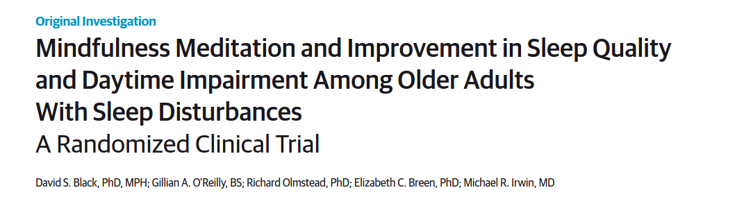
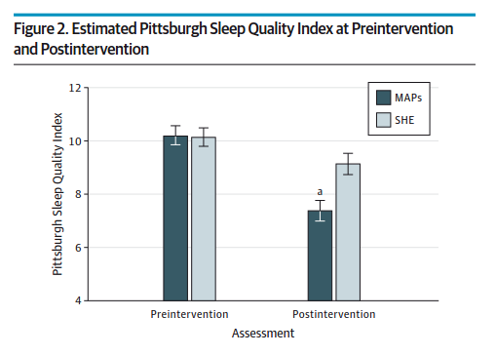

Slide 55
Basic Elements of Yoga Practice
Physical postures/exercises
Breathing exercises
Deep Relaxation
Meditation

Slide 56
Yoga for
Chronic Insomnia

Slide 57



“The [mind-body therapies] resulted in statistically significant improvement in sleep quality and reduction on insomnia severity…which were measured by sleep diary or objective measures.”
“MBTs can be effective in treating insomnia and improving sleep quality for healthy individuals and clinical patients.”

Slide 58
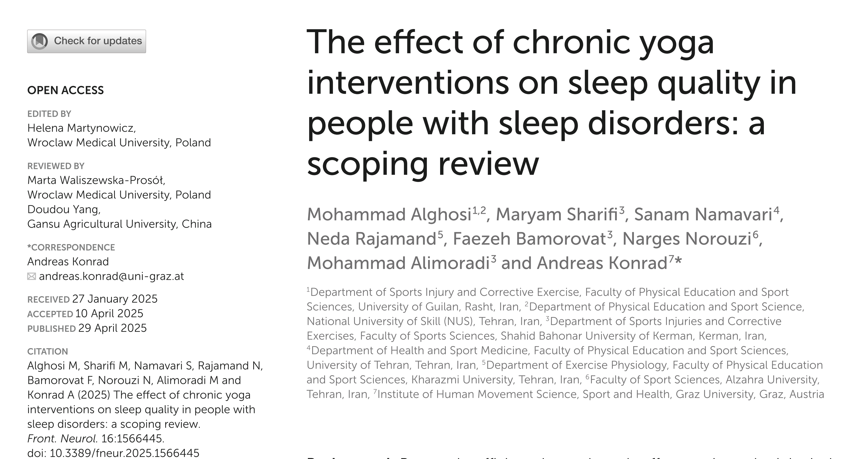
“Tailoring yoga interventions by duration and frequency is valuable, with chronic practice offering a safe, effective alternative to medication.”

Slide 59
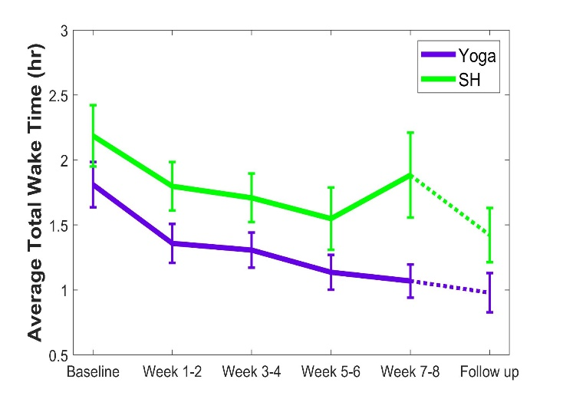

Yoga for Chronic Insomnia RCT
From: Treatment of Chronic Primary Sleep Onset Insomnia With Kundalini Yoga: A Randomized Controlled Trial With Active Sleep Hygiene Comparison. Khalsa SBS, Goldstein MR, Journal of Clinical Sleep Medicine, 17:1841–1852,2021.

Slide 60
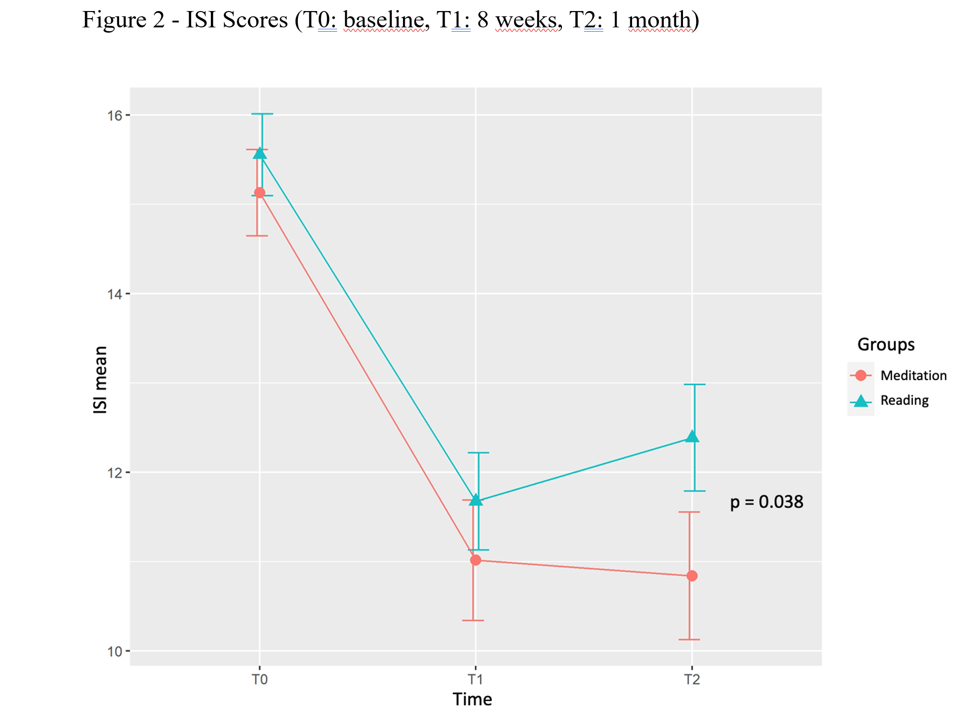
Shabad Kriya for Chronic Insomnia RCT
From: Shabad Kriya Meditation for the Treatment of Insomnia: A Randomized Clinical Trial. Cruz MVP, Khalsa SBS, ..., Rubens Lene Carvalho Tavares RLC. (in preparation).

Slide 61
“The [mind-body therapies] resulted in statistically significant improvement in sleep quality and reduction on insomnia severity but no significant effects on sleep quantity indices...”

Slide 62
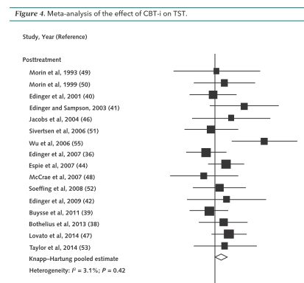


Yoga for Chronic Insomnia RCT Comparison
Measure Yoga Meta
SOL (min) -17.3 -19.0
WASO (min) -15.6 -26.0
SE (%) 10.1 9.9
TST (min) 65.5 7.6

Slide 63
Future Directions

Slide 64

Tailored Viniyoga for Chronic Insomnia
From: Tailored individual Yoga practice improves sleep quality, fatigue, anxiety, and depression in chronic insomnia disorder. Turmel D, Carlier S, Bruyneel AV, Bruyneel M. BMC Psychiatry. 22:267, 2022.

Slide 65

Multi-component Behavioral
Treatment for Insomnia
From: Perceived benefits in a behavioral-medicine insomnia program: a clinical report, Jacobs,G.D.; Benson,H.; Friedman,R., American Journal of Medicine 100:212-216, 1996

Slide 66




Slide 67



Slide 68

Kundalini Research Institute
https://kundaliniresearchinstitute.org/en/yoga-research/

Slide 69


Slide 70


Medical textbook with 24 chapters, 576 pages
~100 international yoga research authors
17 chapters reviewing yoga research in physical and mental health conditions
~40 international yoga therapist contributors
https://us.singingdragon.com/products/the-principles-and-practice-of-yoga-in-health-care-second-edition

Slide 71
  Chapter in book edited by Heather Mason:
  https://www.amazon.com/Yoga-Mental-Health-Conditions-Professionals/dp/1909141356
  Book by Mark Stephens:
  https://www.amazon.com/Yoga-Better-Sleep-Ancient-Science/dp/1623173639
  Book by Lisa Sanfilippo:
  https://www.amazon.com/Yoga-Therapy-Insomnia-Sleep-Recovery-ebook/dp/B07JZJVK9G/ref=sr_1_3
  Lancet review of insomnia:
  https://pubmed.ncbi.nlm.nih.gov/36115372/
  General resources for sleep online:
  https://www.cdc.gov/sleep/index.html
  https://www.nhsinform.scot/illnesses-and-conditions/mental-health/mental-health-self-help-guides/sleep-problems-and-insomnia-self-help-guide/
  https://www.sleepfoundation.org/
  https://www.ninds.nih.gov/Disorders/Patient-Caregiver-Education/Understanding-Sleep
  https://www.webmd.com/sleep-disorders/default.htm
  https://www.psychologytoday.com/us/basics/sleep
  http://www.aasmnet.org
  https://www.nhlbi.nih.gov/science/sleep-science-and-sleep-disorders
Resources

Slide 72


https://www.handspringpublishing.com/product/yoga-for-mental-health/

